Slide 1

Actions, JavascriptExecutor - 15
Orion Innovation
Company Overview

Slide 2
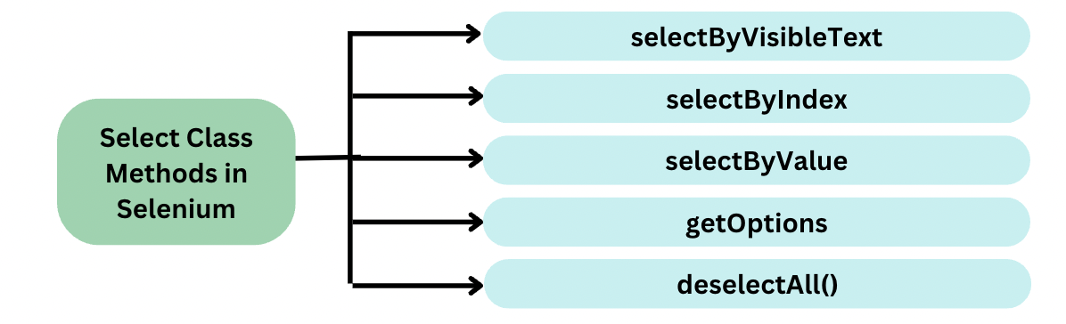
Previous Lesson’s Highlights
DROPDOWN
Source: [1] Handle of selecting the dropdown items
Select drpCountry = new Select(driver.findElement(By.name("country")));
drpCountry.selectByVisibleText("ALBANIA");
drpCountry.selectByIndex(0);
drpCountry.selectByValue(“1");
drpCountry.deselectAll();
Source: [2] Country DropDown

Slide 3
Previous Lesson’s Highlights
File Upload
File Upload Types
sendKeys() method
Robot class
Using AutoIT tool
Using SetFileDetector() Method
sendKeys() Method:
WebElement chooseFile= driver.findElement(By.xpath("//input[@id='file-upload']"));
chooseFile.sendKeys("C:\\Users\\UserB\\IdeaProjects\\SDETProject\\src\\test\\java\\Lesson_14\\test_File.docx");

Slide 4
Previous Lesson’s Highlights
File Upload
Robot Class
//Create object for Robot class
Robot robot = new Robot();
//Store the path of the file to be uploaded using StringSelection Class Object
StringSelection filepath = new StringSelection("C:\\Users\\UserA\\IdeaProjects\\Lesson_2_Methods\\src\\test\\java\\Lesson_14\\image.png");
//Copy above path to Clipboard
Toolkit.getDefaultToolkit().getSystemClipboard().setContents(filepath, null);
//Press Control&V to paste the above path
robot.keyPress(KeyEvent.VK_CONTROL);
robot.keyPress(KeyEvent.VK_V);
Thread.sleep(1000);
//Release Control & V buttons
robot.keyRelease(KeyEvent.VK_V);
robot.keyRelease(KeyEvent.VK_CONTROL);
//Press Enter
robot.keyPress(KeyEvent.VK_ENTER);
//Release Enter
robot.keyRelease(KeyEvent.VK_ENTER);
Source: [3] Keyboard Actions in Robot Class

Slide 5
Previous Lesson’s Highlights
File Upload
SetFileDetector() Method
Step 1: Set Up the Remote WebDriver
WebDriver driver = new RemoteWebDriver(new URL("http://localhost:4444/wd/hub"), new ChromeOptions());
Step 2: Enable File Detector
((RemoteWebDriver) driver).setFileDetector(new LocalFileDetector());
Step 3: Locate the File Upload Element
WebElement uploadElement = driver.findElement(By.id("upload"));
Step 4: Upload the File
uploadElement.sendKeys("/path/to/local/file.txt");
Source: [4] Steps of SetFileDetector() Method

Slide 6
Content
Actions
JavaScriptExecutor

Slide 7
ACTIONS
During test automation, it allows you to perform all operations that you can do with the mouse and keyboard.
Example:
Actions action = new Actions(driver);
action.moveToElement(element).click().perform();
Source: [5] Actions Class

Slide 8
Methods of Action Class
Mouse Actions in Selenium:
doubleClick(): Performs double click on the element
clickAndHold(): Performs long click on the mouse without releasing it
dragAndDrop(): Drags the element from one point and drops to another
moveToElement(): Shifts the mouse pointer to the center of the element
contextClick(): Performs right-click on the mouse
Keyboard Actions in Selenium:
sendKeys(): Sends a series of keys to the element
keyUp(): Performs key release
keyDown(): Performs keypress without release
Source: [5] Methods for Actions Class

Slide 9
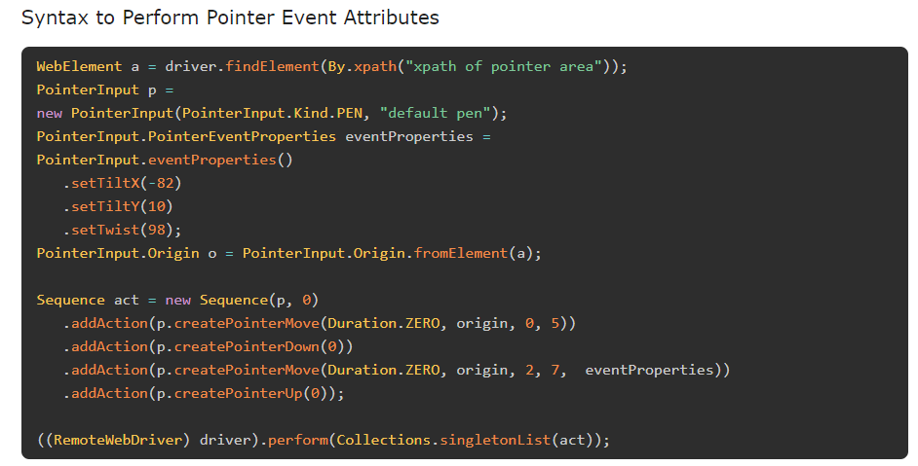
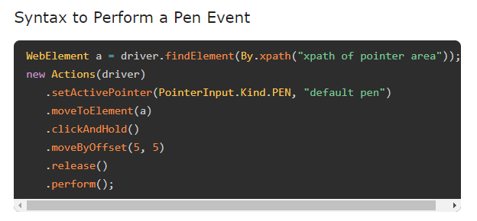
What is a Pen Action?
A pen is similar to a pointer input which has the similar characteristics of a mouse. It can also have the event properties which is distinct to a stylus. While a mouse consists of five buttons, a pen is only capable of three buttons namely, 0 for touch contact which is similar to a left click, 2 for barrel button which is similar to a right click, and 5 for eraser button (this is still unsupported by drivers).
Source: [6] Pen Action

Slide 10
JavaScriptExecutor
JavaScriptExecutor is an interface provided by Selenium WebDriver.
It allows the execution of JavaScript code within the context of the browser.
Why Use JavaScriptExecutor?
Overcome limitations of WebDriver's native methods.
Interact with elements not easily accessible using standard WebDriver commands.
Perform actions such as scrolling, clicking hidden elements, and getting hidden text.
Source: [4] Definition of JavascriptExecutor

Slide 11
JavaScriptExecutor
JavascriptExecutor js = (JavascriptExecutor) driver;
// Scroll down the page by 1000 pixels
js.executeScript("window.scrollBy(0,1000)");
// Click an element using JavaScript
WebElement element = driver.findElement(By.id("elementID")); js.executeScript("arguments[0].click();", element);
Source: [7] Definition of JavascriptExecutor

Slide 12
JavaScriptExecutor
JavascriptExecutor js = (JavascriptExecutor) driver;
// Get value of an input field
WebElement element = driver.findElement(By.id("elementID"));
String value = (String) js.executeScript("return arguments[0].value;", element);
// Highlight an element
WebElement element = driver.findElement(By.id("elementID")); js.executeScript("arguments[0].style.border='3px solid red'", element);
Source: [7] Definition of JavascriptExecutor

Slide 13
JavaScriptExecutor
JavascriptExecutor js = (JavascriptExecutor) driver;
// Generate Alert Pop Window
js.executeScript("alert(‘hello world’);");
// Refresh the browser window
js.executeScript("location.reload()");
Source: [7] Definition of JavascriptExecutor

Slide 14
References
[1] https://www.browserstack.com/guide/select-class-in-selenium
[2] https://www.guru99.com/select-option-dropdown-selenium-webdriver.html
[3] https://www.numpyninja.com/post/a-detailed-guide-on-how-to-do-file-upload-by-keyboard-mouse-actions-using-robot-class
[4] https://chatgpt.com/
[5] https://www.browserstack.com/guide/action-class-in-selenium
[6]https://www.tutorialspoint.com/selenium/selenium_webdriver_pen_events.htm
[7]https://www.geeksforgeeks.org/javascriptexecutor-in-selenium/

Slide 15
Thanks

